Slide 1


FYP-II
Securo-Guard E-commerce Fake Review Detection Web-App
Team Member Faarah Khan
Hafsa Nisar Supervisor Mr. Afzal Hussain
Co-Supervisor Mr. Maaz Ahmed
Department of Computing, FEST
Hamdard University

Slide 2

Table of Contents
Problem Statement
Solution Overview
FYP Scope
Objective
Our methodology
Our Project Plan
FYP Deliverables
Budget / Costing
100% of Work (Demo)
Test Plan & Test Cases
References

Slide 3

Problem Statement
“Identifying Fake Reviews in E-commerce”
Fake reviews on shopping websites mislead customers into buying low-quality products and harm honest businesses. These reviews are often so convincing that it’s hard to tell what’s real. Current methods to detect fake reviews aren’t effective enough. This project aims to understand how fake reviews are written and create better ways to spot them, helping people shop with confidence.

Slide 4
Solution Overview
Web-based SecuroGuard tool user pastes any product link from major e-commerce sites.
AI + NLP engine instantly scores each review and flags likely fakes.
Clean dashboard shows genuine vs fake counts, confidence scores, and simple charts.
Secure, Google-authenticated accounts model keeps learning as new data arrives.
Modular PHP-Python-MySQL stack that scales easily and offers API integration for future expansion.

Slide 5
FYP Scope
Supported Platforms (Current Release) – accepts product links from Amazon (and other major sites tested) and analyzes English-language text reviews only.
End-to-End Real-Time Pipeline – fetches reviews, runs the Python ML/NLP model, and returns fake-vs-genuine counts with confidence scores in seconds.
User-Facing Web Dashboard – responsive interface built with HTML/CSS/JavaScript + Bootstrap, showing summary cards, charts, and recent-search history.
Secure Account & Data Storage – Google / email login, PHP session handling, and MySQL tables for users, analyses, and downloadable PDF/CSV reports.
Defined Technical Boundary – modular PHP-backend + Python micro-service on a local server; no mobile app or browser extension included in this FYP phase.

Slide 6
Objective
Efficient Data Collection:
Develop a privacy-compliant system to gather reviews from e-commerce platforms.
Advanced Detection Model:
Analyze review patterns using AI to identify suspicious content.
Accurate Classification:
Implement machine learning algorithms for reliable review verification.
Continuous Improvement:
Evaluate and refine the system through feedback and performance testing.
Real-Time Analysis:
Enable quick and accurate detection to boost customer trust and fairness.

Slide 7

Our Methodology
“Securo-Guard detects fake e-commerce reviews using a spiral model for iterative development and continuous updates, ensuring effective, reliable, and user-friendly fraud detection”
WHY?
Mitigates risks early and adapts to fraud tactics.
Ensures accuracy through iterative refinement.
Enhances user-friendliness with regular updates.

Slide 8
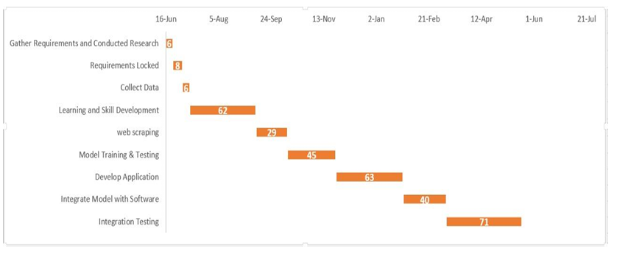
Our Project Plan
Gantt Chart

Slide 9
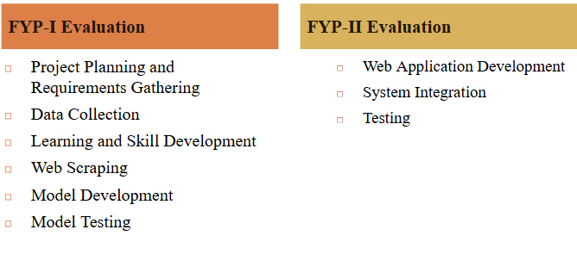
FYP Deliverables

Slide 10
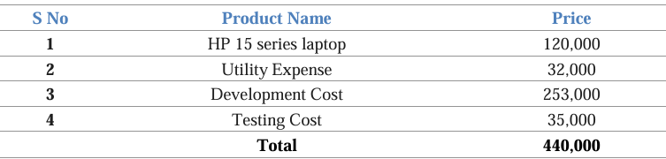
Budget / Costing

Slide 11
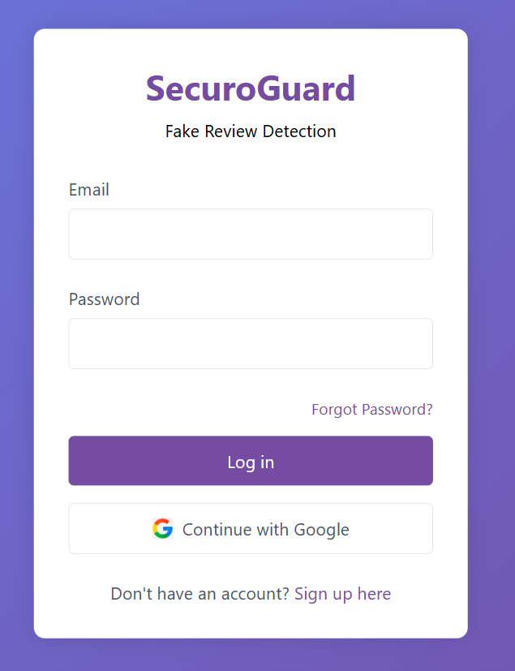
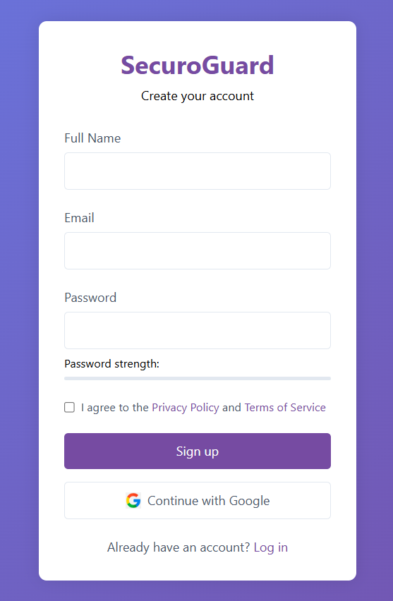
Demo ( Login+Signup Page )

Slide 12
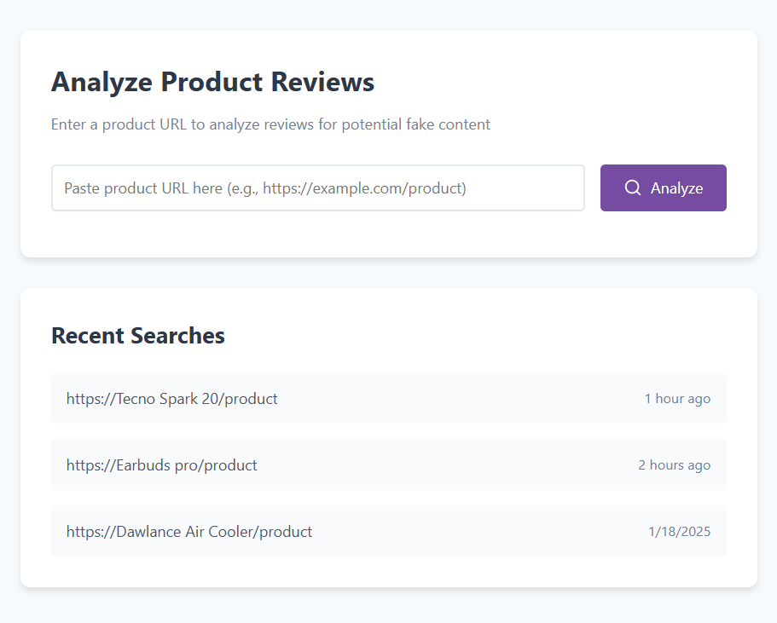
Demo ( URL-Input Page )

Slide 13
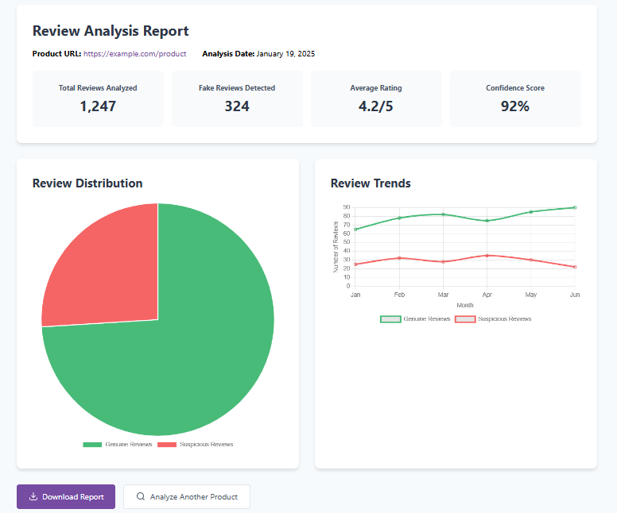
Demo ( Report Page )

Slide 14
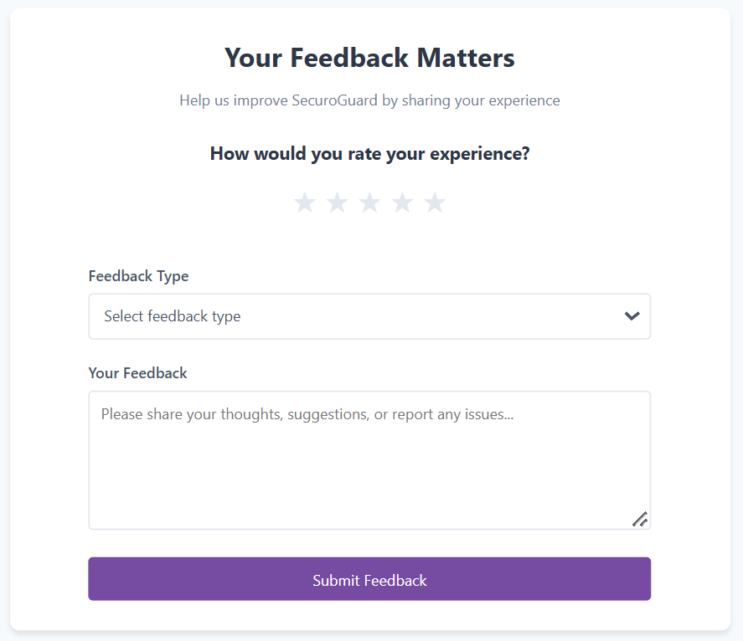
Demo ( Feedback Page )

Slide 15
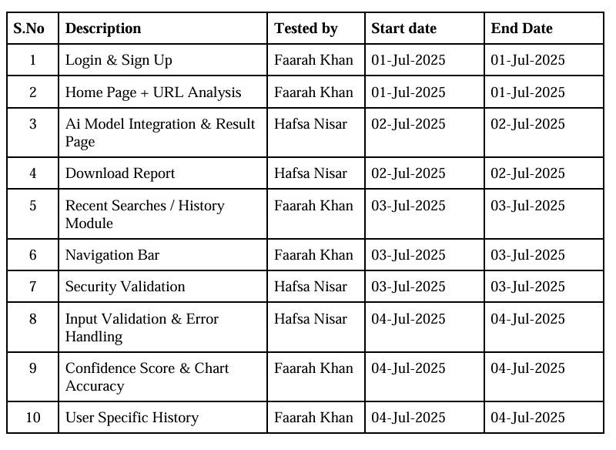
Test Plan & Test Cases

Slide 16
Reference
[1] Fake review detection in e-Commerce platforms using aspect-based sentiment analysis. Journal of Business Research. November 2023, Volume 167, Pages 114143. Petr Hajek, Lubica Hikkerova, Jean-Michel Sahut. Accessed June 30, 2024. Available at: https://doi.org/10.1016/j.jbusres.2023.114143.
[2] Fake review detection system for online E-commerce platforms: A supervised general mixed probability approach. Decision Support Systems. December 2023, Volume 175, Page 114045. Jiwei Luo, Jian Luo, Guofang Nan, Dahui Li. Accessed June 30, 2024. Available at: https://doi.org/10.1016/j.dss.2023.114045.
[3] DRI-RCNN: An approach to deceptive review identification using recurrent convolutional neural network. Information Processing & Management. March 2018, Volume 54, Issue 2, Pages 255-268. Wen Zhang, Yuhang Du, Taketoshi Yoshida, Qing Wang. Accessed June 30, 2024. Available at: https://doi.org/10.1016/j.ipm.2018.03.007.
[4] Kumar, A., Gopal, R. D., Shankar, R., Tan, K. H. (2022). Fraudulent review detection model focusing on emotional expressions and explicit aspects: investigating the potential of feature engineering. Decision Support Systems, Volume 155, April 2022, 113728. Accessed June 30, 2024. Available at: https://doi.org/10.1016/j.dss.2021.113728.
[5] Opinion spam detection by incorporating multimodal embedded representation into a probabilistic review graph. November 13, 2019. Neurocomputing. Last accessed June 30, 2024. Authors: Liu Yuanchao, Pang Bo, Wang Xiaolong. https://doi.org/10.1016/j.neucom.2019.08.013

Slide 17

THANK YOU
Securing Trust in Every Click !

